Slide 1
LPC2148 MICROCONTROLLER
Dr. Kavya B S
Dept. of ECE
MIT
Bangalore

Slide 2
Introduction to LPC2148 Microcontroller
The LPC2141/42/44/46/48 microcontrollers are based on a 16-bit/32-bit ARM7TDMI-S CPU
Has embedded high-speed flash memory
A 128-bit wide memory interface and a unique accelerator architecture
16-bit Thumb mode reduces code by more than 30 % with minimal performance penalty.
Ideal for applications where miniaturization is a key requirement, such as access control and point-of-sale.
Serial communications interfaces makes them well suited for:
communication gateways and protocol converters
soft modems
voice recognition and low end imaging
Presence of various peripheral devices make these microcontrollers suitable for industrial control and medical systems.

Slide 3
Features of LPC2148 Microcontroller
16-bit/32-bit ARM7TDMI-S microcontroller in a tiny LQFP64 package.
8 kB to 40 kB of on-chip static RAM and 32 kB to 512 kB of on-chip flash memory.
128-bit wide interface/accelerator enables high-speed 60 MHz operation.
In-System Programming/In-Application Programming (ISP/IAP) via on-chip boot loader software.
EmbeddedICE RT and Embedded Trace interfaces offer real-time debugging with the on-chip RealMonitor software and high-speed tracing of instruction execution.
USB 2.0 Full-speed compliant device controller with 2 kB of endpoint RAM.
One or two (LPC2141/42 vs. LPC2144/46/48) 10-bit ADCs provide a total of 6/14 analog inputs, with conversion times as low as 2.44 ms per channel.
Single 10-bit DAC provides variable analog output (LPC2142/44/46/48 only).
Two 32-bit timers/external event counters (with four capture and four compare channels each), PWM unit (six outputs) and watchdog.

Slide 4
Features of LPC2148 Microcontroller
Low power Real-Time Clock (RTC) with independent power and 32 kHz clock input.
Multiple serial interfaces
Two UARTs (16C550)
Two Fast I²C-bus (400 kbit/s)
SPI
SSP
Vectored Interrupt Controller (VIC) with configurable priorities and vector addresses.
Up to 45 of 5 V tolerant fast general purpose I/O pins in a tiny LQFP64 package.
Up to 21 external interrupt pins available.
60 MHz maximum CPU clock available from programmable on-chip PLL with settling time of 100 ms.
On-chip integrated oscillator operates with an external crystal from 1 MHz to 25 MHz.
Power saving modes: Idle and Power-down.
Individual enable/disable of peripheral functions as well as peripheral clock scaling for additional power optimization.
Processor wake-up from Power-down mode via external interrupt or BOD.
Single power supply chip with POR and BOD circuits:
CPU operating voltage range of 3.0 V to 3.6 V (3.3 V ± 10 %) with 5 V tolerant I/O pads.

Slide 5
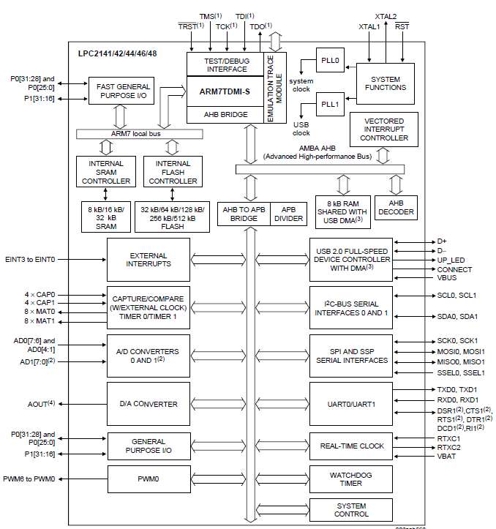
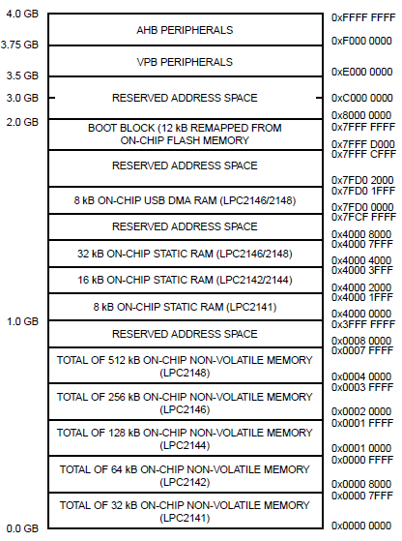
Block Diagram/Architecture of LPC2148 Microcontroller

Slide 6
Introduction to LPC2148 Microcontroller
Interrupt controller
The Vectored Interrupt Controller (VIC) accepts all of the interrupt request inputs and categorizes them as:
Fast Interrupt Request (FIQ)
vectored Interrupt Request (IRQ)
non-vectored IRQ as defined by programmable settings.
Priorities of interrupts from the various peripherals can be dynamically assigned and adjusted.
FIQ has the highest priority.
Vectored IRQs have the middle priority.
Non-vectored IRQs have the lowest priority.
The VIC combines the requests from all the vectored and non-vectored IRQs to produce the IRQ signal to the ARM processor.
Interrupt sources
Each peripheral device has one interrupt line connected to the VIC
May have several internal interrupt flags. Individual interrupt flags may also represent more than one interrupt source.

Slide 7
Introduction to LPC2148 Microcontroller
Pin connect block
Allows selected pins of the microcontroller to have more than one function
Configuration registers control the multiplexers to allow connection between the pin and the on chip peripherals.
Peripherals should be connected to the appropriate pins prior to being activated, and prior to any related interrupt(s) being enabled.
The Pin Control Module with its pin select registers defines the functionality of the microcontroller
The Pin Control Module contains 3 registers which enable read/write operations -
PINSEL0
PINSEL1
PINSEL2

Slide 8
Introduction to LPC2148 Microcontroller
Fast general purpose parallel I/O (GPIO)
Pins may be dynamically configured as inputs or outputs.
Separate registers allow setting or clearing any number of outputs simultaneously.
LPC2141/42/44/46/48 introduce accelerated GPIO functions:
GPIO registers are relocated to the ARM local bus for the fastest possible I/O timing.
Mask registers allow treating sets of port bits as a group, leaving other bits unchanged.
All GPIO registers are byte addressable.
Entire port value can be written in one instruction.
Features
Bit-level set and clear registers allow a single instruction set or clear of any number of bits in one port.
Direction control of individual bits.
Separate control of output set and clear.
All I/O default to inputs after reset.

Slide 9
Introduction to LPC2148 Microcontroller
10-bit ADC
10-bit successive approximation analog to digital converter.
Measurement range of 0 V to VREF (2.0 V ≤ VREF ≤ VDDA).
Each converter capable of performing more than 400000 10-bit samples per second.
Every analog input has a dedicated result register to reduce interrupt overhead.
Burst conversion mode for single or multiple inputs.
Optional conversion on transition on input pin or timer match signal.
Global Start command for both converters

Slide 10
Introduction to LPC2148 Microcontroller
10-bit DAC
10-bit DAC.
Buffered output.
Power-down mode available.

Slide 11
Introduction to LPC2148 Microcontroller
USB 2.0 device controller
Fully compliant with USB 2.0 Full-speed specification.
Supports 32 physical (16 logical) endpoints.
Supports control, bulk, interrupt and isochronous endpoints.
Scalable realization of endpoints at run time.
Endpoint maximum packet size selection (up to USB maximum specification) by software at run time.
Supports DMA transfer on all non-control endpoints
One duplex DMA channel serves all endpoints

Slide 12
Introduction to LPC2148 Microcontroller
UARTs
16 bytes Receive and Transmit FIFOs.
Receiver FIFO trigger points at 1 B, 4 B, 8 B, and 14 B
Built-in fractional baud rate generator covering wide range of baud rates without a need for external crystals of particular values.
Transmission FIFO control enables implementation of software (XON/XOFF) flow control on both UARTs.
LPC2144/46/48 UART1 equipped with standard modem interface signals.
Module also provides full support for hardware flow control (auto-CTS/RTS).

Slide 13
Introduction to LPC2148 Microcontroller
I2C-bus serial I/O controller
Compliant with standard I2C-bus interface.
Easy to configure as master, slave, or master/slave.
Programmable clocks allow versatile rate control.
Bidirectional data transfer between masters and slaves.
Multi-master bus (no central master).
Arbitration between simultaneously transmitting masters without corruption of serial data on the bus.
Serial clock synchronization allows devices with different bit rates to communicate via one serial bus.
Serial clock synchronization can be used as a handshake mechanism to suspend and resume serial transfer.
The I2C-bus can be used for test and diagnostic purposes

Slide 14
Introduction to LPC2148 Microcontroller
Serial Peripheral Interface(SPI) serial I/O controller
The LPC2148 contain one SPI controller.
Compliant with SPI specification.
Synchronous, Serial, Full Duplex, Communication.
Combined SPI master and slave.
Maximum data bit rate of one eighth of the input clock rate.
Synchronous Serial Port(SSP) serial I/O controller
Compatible with Motorola’s SPI, TI’s 4-wire SSI and National Semiconductor’s Microwire buses.
Synchronous serial communication.
Master or slave operation.
8-frame FIFOs for both transmit and receive.
Four bits to 16 bits per frame.

Slide 15
Introduction to LPC2148 Microcontroller
General purpose timers/external event counters
A 32-bit timer/counter with a programmable 32-bit prescaler.
External event counter or timer operation.
Four 32-bit capture channels per timer/counter that can take a snapshot of the timer value when an input signal transitions. A capture event may also optionally generate an interrupt.
Four 32-bit match registers that allow:
Continuous operation with optional interrupt generation on match.
Stop timer on match with optional interrupt generation.
Reset timer on match with optional interrupt generation.
Four external outputs per timer/counter corresponding to match registers, with the following capabilities:
Set LOW on match.
Set HIGH on match.
Toggle on match.
Do nothing on match.

Slide 16
Introduction to LPC2148 Microcontroller
Watchdog timer
Internally resets chip if not periodically reloaded.
Debug mode.
Enabled by software but requires a hardware reset or a watchdog reset/interrupt to be disabled.
Incorrect/Incomplete feed sequence causes reset/interrupt if enabled.
Flag to indicate watchdog reset.
Programmable 32-bit timer with internal pre-scaler.

Slide 17
Introduction to LPC2148 Microcontroller
Real-time clock
Measures the passage of time to maintain a calendar and clock.
Ultra-low power design to support battery powered systems.
Provides Seconds, Minutes, Hours, Day of Month, Month, Year, Day of Week, and Day of Year.
Can use either the RTC dedicated 32 kHz oscillator input or clock derived from the external
Dedicated power supply pin can be connected to a battery or the main 3.3 V

Slide 18
Introduction to LPC2148 Microcontroller
Pulse width modulator
Supports single edge controlled and/or double edge controlled PWM outputs.
Pulse period and width can be any number of timer counts.
All PWM outputs will occur at the same repetition rate.
Double edge controlled PWM outputs can be programmed to be either positive going or negative going pulses.
Match register updates are synchronized with pulse outputs to prevent generation of erroneous pulses.
May be used as a standard timer if the PWM mode is not enabled.
A 32-bit Timer/Counter with a programmable 32-bit Prescaler

Slide 19
Introduction to LPC2148 Microcontroller
System control
Crystal oscillator
PLL
Reset and wake-up timer
Brownout detector
Code security
External interrupt inputs
Memory mapping control
Power control
Idle mode
Power-down mode
APB bus

Slide 20
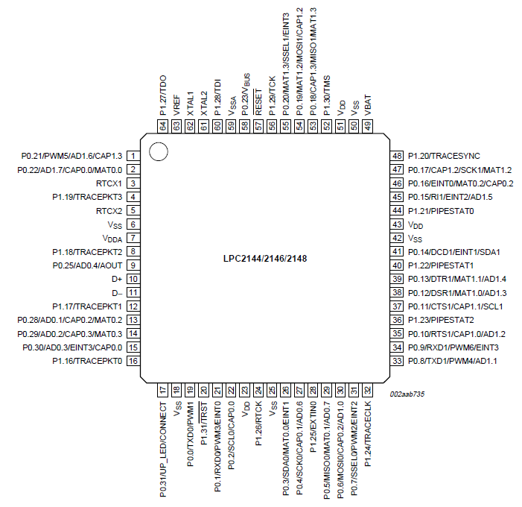
LPC2148 Pin diagram

Slide 21
LPC2148 GPIO Ports and Registers
Introduction
64 pins are attached to two 32-bit I/O ports: Port-0 & Port-1.
Port-0, Port-1 pins are designated as P0.0 – P0.31 & P1.0 - P1.31.
Pins P0.24, P0.26, P0.27, P1.0-P1.15 are unavailable.
Almost every pin of these two ports has some alternate function available. For example: P0.0 can be configured as the TXD pin for UART0 or as PWM1 pin as well
Pin functions are multiplexed, up to 4 functions assigned to each pin.
Port-0 pins multiplex peripheral pin, & comm. interface pin functions
Port-1 pins multiplex JTAG interface, Trace function
Advantages: keeps size small, adds more functionalities to devices
Disadvantages: if functions not carefully selected, some can’t be availed
The functionality of each pin can be selected using the Pin Function Select Registers.

Slide 22
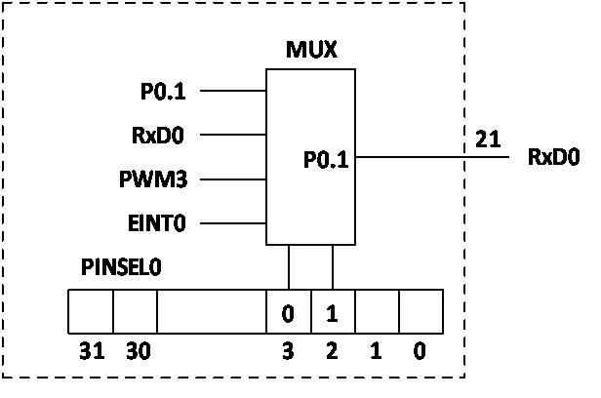
PIN connect block in LPC2148 microcontroller
Pin Function Select Registers
Pin Function Select Registers are 32-bit registers. These registers are used to select or configure specific pin functionality.
There are 3 Pin Function Select Registers in LPC2148:
PINSEL0 : - used to configure PORT0 pins P0.0 to P0.15.
PINSEL1 : - used to configure PORT0 pins P0.16 to P0.31.
PINSEL2 : - used to configure PORT1 pins P1.16 to P1.31.
Value | Function | Enumeration
00 | Primary (default) function, typically GPIO port | PINSEL_FUNC_0
01 | First alternate function | PINSEL_FUNC_1
10 | Second alternate function | PINSEL_FUNC_2
11 | Third alternate function | PINSEL_FUNC_3

Slide 23
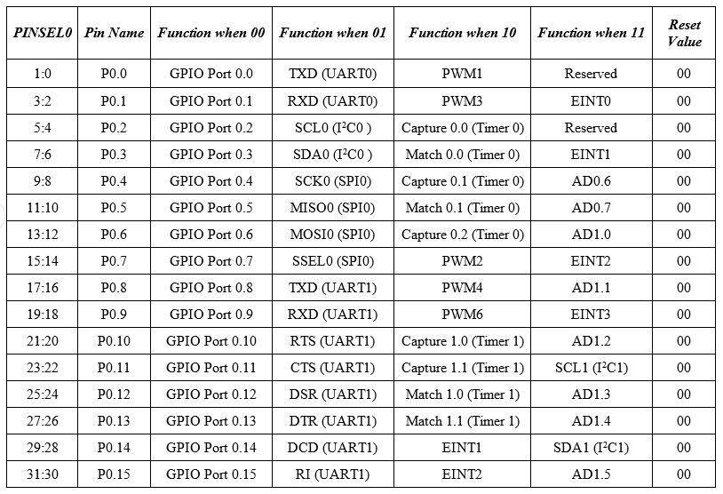
PIN connect block in LPC2148 microcontroller

Slide 24
PIN connect block in LPC2148 microcontroller
Pin Function Select Registers
Pin Function Select Registers are 32-bit registers. These registers are used to select or configure specific pin functionality.
There are 3 Pin Function Select Registers in LPC2148:
PINSEL0 : - used to configure PORT0 pins P0.0 to P0.15.
PINSEL1 : - used to configure PORT0 pins P0.16 to P0.31.
PINSEL2 : - sed to configure PORT1 pins P1.16 to P1.31.
Pin function selection: Examples
Configuring P0.0 and P0.1 of Port-0 as I/O pins for TxD0 and RxD0 functions of UART0 in ‘C’:
PINSEL0=0x00000000;
//clear bits[3:2], [1:0] of PINSEL0 register, hence assign P0.0, P0.1 general purpose I/O function
PINSEL0=0x00000005;
/place 01 in bits[3:2], [1:0] of PINSEL0 register which selects TxD0 for P0.0 & RxD0 for P0.1 pins

Slide 25
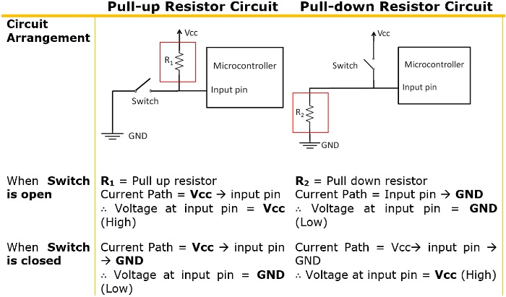
LPC2148 microcontroller GPIO registers
GPIO ports
The Port 0 pins do not have built-in pull-up or pull-down resistors.
Programmer Responsibility to connect pull-up or pull-down resistors externally.
GPIO function is the most frequently used functionality of the microcontroller.

Slide 26
LPC2148 microcontroller GPIO registers
Fast and Slow GPIO Registers
5 Fast (also called Enhanced GPIO Features Registers) GPIO Registers
4 Slow (also called Legacy GPIO Registers) GPIO Registers available
The Slow Registers allow backward compatibility with earlier family devices using the existing codes.
The GPIO function in both the Ports are controlled by a set of 4 registers:
IOPIN
IODIR
IOSET and
IOCLR

Slide 27
LPC2148 microcontroller GPIO registers
Slow GPIO Registers
The GPIO function in both the Ports are controlled by a set of 4 registers:
IOxPIN, IOxDIR, IOxSET and IOxCLR.
IOxPIN (GPIO Port Pin value register):
This is a 32-bit wide register.
This register is used to read/write the value on Port (PORT0/PORT1).
But care should be taken while writing.
Masking should be used to ensure write to the desired pin.
Examples :
Writing 1 to P0.4 using IO0PIN
IO0PIN = IO0PIN | (1<<4) ;This method should be avoided, as all other pins are forced to be assigned ‘0’
Writing 0 to P0.4 using IO0PIN
IO0PIN = IO0PIN & (~(1<<4) )
Writing F to P0.7-P0.4
IO0PIN = IO0PIN | (0x000000F0)

Slide 28
LPC2148 microcontroller GPIO registers
IOxDIR(GPIO port Direction Control register ):
Used to set the direction i.e. either input or output of individual pins.
When a bit is set to ‘0’, the corresponding pin is configured as Input.
When a bit is set as ‘1’, the corresponding pin is configured as Output.
The syntax for this register is IOxDIR, where ‘x’ is the port number i.e. IO0DIR for PORT0 and IO1DIR for PORT1.

Slide 29
LPC2148 microcontroller GPIO registers
IOxSET(GPIO Port Output Set Register)
Used to set the value of a GPIO pin that is configured as output to High (Logic 1).
When a bit in the IOSET register is set to ‘1’, the corresponding pin is set to Logic 1.
Setting a bit ‘0’ in this register has no effect on the pin.
The syntax for this register is IOxSET, where ‘x’ is the port number i.e. IO0SET for PORT0 and IO1SET for PORT1.
IOxCLR(GPIO Port Output Clear Register)
Used to set the value of a GPIO pin that is configured as output to Low (Logic 0).
When a bit in the IOCLR register is set to ‘1’, the corresponding pin in the respective Port is set to Logic 0
At the same time clears the corresponding bit in the IOSET register.
Setting ‘0’ in the IOCLR has no effect on the pin.
The syntax for this register is IOxCLR, where ‘x’ is the port number i.e. IO0CLR for PORT0 and IO1CLR for PORT1.

Slide 30
LPC2148 microcontroller GPIO registers
Pin programming
Method 1: IO0DIR = (1<<3);
Direct assignment method where ‘1’ is set directly on the pin.
All the other pins are set to 0.
This method should be avoided as all the other pins are forced to be assigned ‘0’.
Method 2: IO0DIR | = 0x00000008;
Hexadecimal value of the register is assigned after ORing the register with itself.
Other pins are not affected.
This method is useful if we want to assign many pins without affecting the other pins.
Method 3: IO0DIR | = (1<<3);
This is similar to the above method except that only a single pin is affected.
Other registers can also be set using the same methods.

Slide 31
LPC2148 microcontroller GPIO registers
Example: set pin 15 of PORT0(i.e. P0.15) as output and drive the pin High.
For this we need to use two registers: IODIR and IOSET.
IO0DIR | = (1<<15); // Configuring P0.15 as output.
IO0SET | = (1<<15); // Make the O/P pin P0.15 as High
Example: set pin 11 of PORT0 as output and the output logic ‘1’ on this pin and then to logic 0.
For this we need to use three registers: IODIR, IOSET and IOCLR.
IO0DIR | = (1<<11); // Configuring P0.11 as output.
IO0SET | = (1<<11); // Make the O/P pin P0.11 as High.
IO0CLR | = (1<<11); // Make the O/P pin P0.11 as Low.
Example: set more than one pin as output and the value of that pin must be HIGH. Consider pins 7 and 14 of PORT0 (P0.7 and P0.14).
IO0DIR | = (1<<7) | (1<<14); // Configuring pins P0.7 and P0.14 as output.
IO0SET | = (1<<7) | (1<<14); // Make the O/P of pins P0.7 and P0.14 as High.

Slide 32
LPC2148 microcontroller GPIO registers
Fast GPIO Registers
There are 5 fast GPIO registers :
FIOxDIR (Fast GPIO Port Direction control register) :
This is a 32-bit wide register.
This register individually controls the direction of each port pin.
Setting a bit to ‘1’ configures the corresponding pin as an output pin.
Setting a bit to ‘0’ configures the corresponding pin as an input pin.
FIOxMASK (Fast Mask register for port) :
This is a 32-bit wide register.
This register controls the effect of fast registers (FIOxPIN, FIOxSET, FIOxCLR) on port pins.
Setting a bit to ‘0’ configures the corresponding pin access to the fast registers i.e. we can write/read the corresponding pin in fast mode using fast registers.
Setting a bit to ‘1’ configures the corresponding pin unaffected by fast registers.

Slide 33
LPC2148 microcontroller GPIO registers
Fast GPIO Registers
FIOxPIN (Fast Port Pin value register using FIOMASK) :
This is a 32-bit wide register.
This register is used to read/write the value on port pins, only if that corresponding port pins have access to fast registers
Access to port pins using fast registers is enabled using Zeroes in FIOxMASK register
FIOxSET (Fast Port Output Set register using FIOMASK) :
This is a 32-bit wide register.
This register is used to make pins of Port HIGH.
Writing one to specific bit makes that pin HIGH.
Writing zero has no effect.
Reading this register returns the current contents of the port output register. Only bits enabled by ZEROES in FIOMASK can be altered.
FIOxCLR (Fast Port Output Clear register using FIOMASK) :
This is a 32-bit wide register.
This register is used to make pins of Port LOW. Writing one to specific bit makes that pin LOW. Writing zeroes has no effect. Only bits enabled by ZEROES in FIOMASK can be altered.

